Slide 1
CA 7503 Software Testing

Slide 2
Lecture 3 : Types of Testing

Slide 3
Verification & Validation
Verification: Demonstration of consistency, completeness, and correctness of the software artifacts at each stage of and between each stage of the software life-cycle.
Different types of verification: manual inspection, testing, formal methods
Verification answers the question: Am I building the product right?
Validation: The process of evaluating software at the end of the software development to ensure compliance with respect to the customer needs and requirements.
Validation can be accomplished by verifying the artifacts produced at each stage of the software development life cycle
Validation answers the question: Am I building the right product?

Slide 4
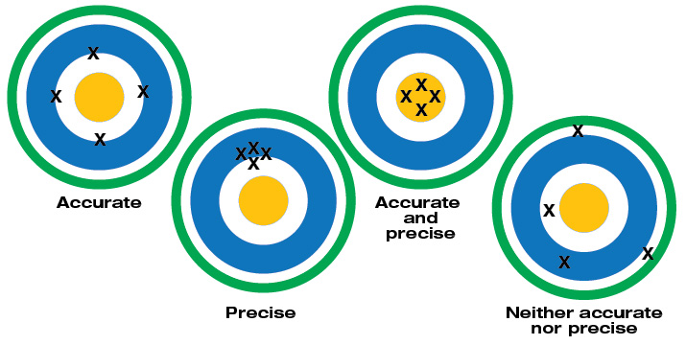
Precision and Accuracy
“Accuracy" is used to describe the closeness of a measurement to the true value.
“Precision” is the closeness of agreement among a set of results.

Slide 5
Precision and Accuracy
As a software tester, it's important to know the difference between precision and accuracy
Testing a Calculator
Should you test that the answers it returns are precise or accurate?
What if the software you're testing is a simulation game such as baseball or a flight simulator? Should you primarily test its precision or its accuracy?
Whether the software you test needs to be precise or accurate depends much on what the product is and ultimately what the development team is aiming at.

Slide 6
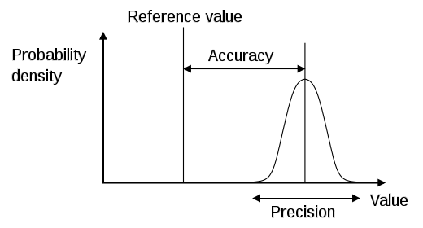
Precision and Accuracy
“Accuracy" is used to describe the closeness of a measurement to the true value.
“Precision” is the closeness of agreement among a set of results.

Slide 7
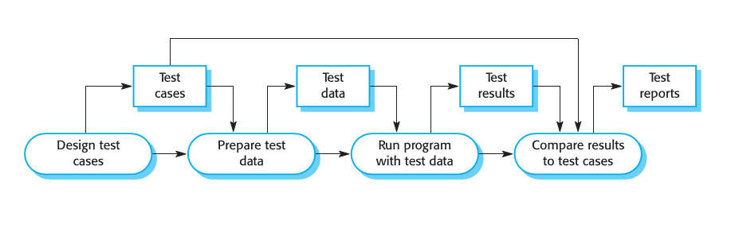
A Software Testing Process
Validation testing
To demonstrate to the developer and the system customer that the software meets its requirements;
A successful test shows that the system operates as intended.
Defect testing
To discover faults or defects in the software where its behaviour is incorrect or not in conformance with its specification;
A successful test is a test that makes the system perform incorrectly and so exposes a defect in the system.

Slide 8
Effectiveness vs. Efficiency
Test Effectiveness
Relative ability of testing strategy to find bugs in the software.
Test Efficiency
Relative cost of finding a bug in the software under test.

Slide 9
What is a successful test?
Pass
Status of a completed test case whose actual results are the same as the expected results.
No Pass
Status of a completed software test case whose actual results differ from the expected ones
“Successful” test (i.e., we want this to happen).

Slide 10
What software testing is not…
Model verification (e.g., by simulation)
Tool-based static code analysis
Human documentation/code scrutiny (inspection)
Debugging:
Testing is NOT debugging, and debugging is NOT testing

Slide 11
Software Testing Features
The scope of testing
The different levels of the system that testing addresses.
Test techniques
Some of the approaches to building and applying tests.
Test management
How we manage the testing process to maximize the effectiveness and efficiency of the process for a given product.

Slide 12
Testing scope
“Testing in the small”(unit testing)
Exercising the smallest executable units of the system.
“Testing the build”(integration testing)
Finding problems in the interaction between components.
“Testing in the large”(system testing)
Putting the entire system to test.

Slide 13
Testing Categorization
Fault-directed testing
Unit testing
Integration testing
Conformance-directed testing
System testing
Acceptance testing

Slide 14
Testing “in the small”
Unit Testing
Exercising the smallest individually executable code units
It is a defect testing process.
Component or unit testing is the process of testing individual components in isolation.
Usually performed by programmers
Objectives
Finding faults
Assure correct functional behaviour of units
Components may be:
Individual functions or methods within an object;
Object classes with several attributes and methods;
Composite components with defined interfaces used to access their functionality.

Slide 15
Object Class Testing
Complete test coverage of a class involves: Testing all operations associated with an object; Setting and interrogating all object attributes; Exercising the object in all possible states.
Inheritance makes it more difficult to design object class tests as the information to be tested is not localized.

Slide 16
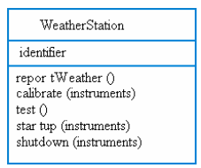
An Example of Object Class Testing
Need to define test cases for reportWeather, calibrate, test, startup and shutdown.
Using a state model, identify sequences of state transitions to be tested and the event sequences to cause these transitions.
For example:
Waiting -> Calibrating -> Testing -> Transmitting -> Waiting

Slide 17
Testing the “build”
Integration Testing
Exercising two or more units or components
Objectives
Detect interface errors
Assure the functionality of the combined units
Performed by programmers or testing group
Issues
Strategy for combining units?
Compatibility with third-party components (e.g., Commercial Of The Shelf – COTS)?
Correctness of third-party components?

Slide 18
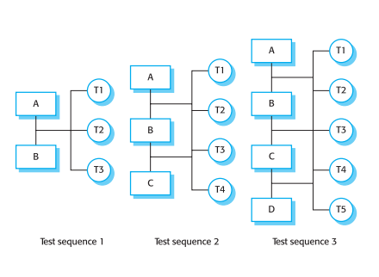
Integration Testing
Involves building a system from its components and testing it for problems that arise from component interactions.
Top-down integration
Develop the skeleton of the system and populate it with components.
Bottom-up integration
Integrate infrastructure components then add functional components.
To simplify error localization, systems should be incrementally integrated.

Slide 19
Testing “in the large”: System
System Testing
Exercising the functionality, performance, reliability, and security of the entire system
Objectives
Find errors in the overall system behavior
Establish confidence in system functionality
Validate non-functional system requirements
Usually performed by a separate testing group

Slide 20
Testing “in the large”: Accept
Acceptance Testing
Operating the system in the user environment with standard user input scenario
Objectives
Evaluate whether the system meets the customer criteria
Determine whether the customer will accept the system
Usually performed by the end user

Slide 21
Testing “in the large”: Operation
Regression Testing
Testing modified versions of a previously validated system
Objectives
Assuring that changes to the system have not introduced new errors
Performed by the system itself or by a regression test group
Capture/Replay (CR) Tools

Slide 22
Test Generation Methods
Black-box testing
No knowledge of the software structure
Also called specification-based or functional testing
White-box testing
Knowledge of the software structure and implementation.
White-box methods can be used for test generation and test adequacy analysis
Usually used as adequacy criteria (after generation by a black-box method)
Methods based on internal code structure: Statement, Branch, Path or Data-flow coverage

Slide 23
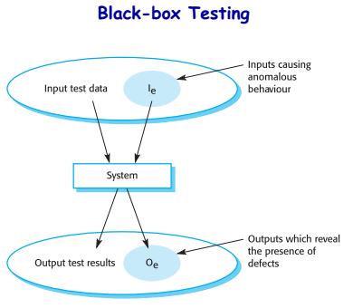
Test Generation Methods
Fault-based testing
Objective is to find faults in the software, e.g., Unit testing
Model-based testing
Use of a data or behaviour model of the software, e.g., finite state machine
Random testing

Slide 24
Testing and Quality Assurance
These two terms are the ones most often used to describe either the group or the process that’s verifying and validating the software.
The goal of a software tester is to find bugs, find them as early as possible, and make sure they get fixed.
A software quality assurance person’s main responsibility is to create and enforce standards and methods to improve the development process and to prevent bugs from ever occurring
Of course, there is overlap
Some testers will do a few QA tasks and some QA-ers will perform a bit of testing. The two jobs and their tasks are intertwined.

Slide 25
Causes of software defects
Faulty requirements definition
Client-developer communication failures
Deliberate deviations from software requirements
Logical design errors
Coding errors
Non-compliance with documentation and coding instructions
Shortcomings of the testing process
User interface and procedure errors
Documentation errors

